Slide 1
Test of hypotheses
Notes:
Faded picture background with full-color overlay
(Intermediate)
Tip: For best results with the picture overlay on this slide, use a picture that is the same dimensions as the slide: 7.5” high and 10” wide. If the picture is not the same height and width, resize or crop to those dimensions before following the instructions below.
To reproduce the background effects on this slide, do the following:
On the Home tab, in the Slides group, click Layout, and then click Blank.
Right-click the slide and then click Format Background.
In the Format Background dialog box, click Fill in the left pane. In the Fill pane, select Picture or texture fill, and then under Insert from, click File.
In the Insert Picture dialog box, select a picture, and then click Insert.
Also in the Format Background dialog box, in the Fill pane, in the Transparency box, enter 50%.
Also in the Format Background dialog box, click Picture Color in the left pane. In the Picture Color pane, under Recolor, click the button next to Presets, and then click Tan, Background color 2 Light (third row, first option from the left).
On the Insert tab, in the Images group, click Picture.
In the Insert Picture dialog box, select the same picture chosen for the background, and then click Insert.
Select the picture. Under Picture Tools, on the Format tab, in the bottom right corner of the Size group, click the Size and Position dialog box launcher. In the Format Picture dialog box, resize or crop the image so that the height is set to 7.5” and the width is set to 2.25”.
To crop the picture, click Crop in the left pane, and in the Crop pane, under Crop position, enter values into the Height, Width, Left, and Top boxes.
To resize the picture, click Size in the left pane, and in the Size pane, under Size and rotate, enter values into the Height and Width boxes.
Also in the Format Picture dialog box, click Glow and Soft Edges in the left pane, and then in the Glow and Soft Edges pane, under Soft Edges, in the Size box enter 10 point.

Slide 2
Test of hypothesis
Researchers are interested in answering many types of questions.
For example, a scientist might want to know whether the earth is warming up.
A physician might want to know whether a new medication will lower a person’s blood pressure.
An educator might wish to see whether a new teaching technique is better than a traditional one.
A retail merchant might want to know whether the public prefers a certain color in a new line of fashion.
Automobile manufacturers are interested in determining whether seat belts will reduce the severity of injuries caused by accidents.
These types of questions can be addressed through statistical hypothesis testing, which is a decision-making process for evaluating claims about a population.
Notes:
Faded picture background with full-color overlay
(Intermediate)
Tip: For best results with the picture overlay on this slide, use a picture that is the same dimensions as the slide: 7.5” high and 10” wide. If the picture is not the same height and width, resize or crop to those dimensions before following the instructions below.
To reproduce the background effects on this slide, do the following:
On the Home tab, in the Slides group, click Layout, and then click Blank.
Right-click the slide and then click Format Background.
In the Format Background dialog box, click Fill in the left pane. In the Fill pane, select Picture or texture fill, and then under Insert from, click File.
In the Insert Picture dialog box, select a picture, and then click Insert.
Also in the Format Background dialog box, in the Fill pane, in the Transparency box, enter 50%.
Also in the Format Background dialog box, click Picture Color in the left pane. In the Picture Color pane, under Recolor, click the button next to Presets, and then click Tan, Background color 2 Light (third row, first option from the left).
On the Insert tab, in the Images group, click Picture.
In the Insert Picture dialog box, select the same picture chosen for the background, and then click Insert.
Select the picture. Under Picture Tools, on the Format tab, in the bottom right corner of the Size group, click the Size and Position dialog box launcher. In the Format Picture dialog box, resize or crop the image so that the height is set to 7.5” and the width is set to 2.25”.
To crop the picture, click Crop in the left pane, and in the Crop pane, under Crop position, enter values into the Height, Width, Left, and Top boxes.
To resize the picture, click Size in the left pane, and in the Size pane, under Size and rotate, enter values into the Height and Width boxes.
Also in the Format Picture dialog box, click Glow and Soft Edges in the left pane, and then in the Glow and Soft Edges pane, under Soft Edges, in the Size box enter 10 point.

Slide 3
Test of hypothesis
There are two specific statistical tests used for hypothesis concerning means:
1. The z-test
2. The t-test
The three methods used to test hypotheses are:
The traditional method
The P-value
The confidence interval method
Notes:
Faded picture background with full-color overlay
(Intermediate)
Tip: For best results with the picture overlay on this slide, use a picture that is the same dimensions as the slide: 7.5” high and 10” wide. If the picture is not the same height and width, resize or crop to those dimensions before following the instructions below.
To reproduce the background effects on this slide, do the following:
On the Home tab, in the Slides group, click Layout, and then click Blank.
Right-click the slide and then click Format Background.
In the Format Background dialog box, click Fill in the left pane. In the Fill pane, select Picture or texture fill, and then under Insert from, click File.
In the Insert Picture dialog box, select a picture, and then click Insert.
Also in the Format Background dialog box, in the Fill pane, in the Transparency box, enter 50%.
Also in the Format Background dialog box, click Picture Color in the left pane. In the Picture Color pane, under Recolor, click the button next to Presets, and then click Tan, Background color 2 Light (third row, first option from the left).
On the Insert tab, in the Images group, click Picture.
In the Insert Picture dialog box, select the same picture chosen for the background, and then click Insert.
Select the picture. Under Picture Tools, on the Format tab, in the bottom right corner of the Size group, click the Size and Position dialog box launcher. In the Format Picture dialog box, resize or crop the image so that the height is set to 7.5” and the width is set to 2.25”.
To crop the picture, click Crop in the left pane, and in the Crop pane, under Crop position, enter values into the Height, Width, Left, and Top boxes.
To resize the picture, click Size in the left pane, and in the Size pane, under Size and rotate, enter values into the Height and Width boxes.
Also in the Format Picture dialog box, click Glow and Soft Edges in the left pane, and then in the Glow and Soft Edges pane, under Soft Edges, in the Size box enter 10 point.

Slide 4
Test of hypothesis
Notes:
Faded picture background with full-color overlay
(Intermediate)
Tip: For best results with the picture overlay on this slide, use a picture that is the same dimensions as the slide: 7.5” high and 10” wide. If the picture is not the same height and width, resize or crop to those dimensions before following the instructions below.
To reproduce the background effects on this slide, do the following:
On the Home tab, in the Slides group, click Layout, and then click Blank.
Right-click the slide and then click Format Background.
In the Format Background dialog box, click Fill in the left pane. In the Fill pane, select Picture or texture fill, and then under Insert from, click File.
In the Insert Picture dialog box, select a picture, and then click Insert.
Also in the Format Background dialog box, in the Fill pane, in the Transparency box, enter 50%.
Also in the Format Background dialog box, click Picture Color in the left pane. In the Picture Color pane, under Recolor, click the button next to Presets, and then click Tan, Background color 2 Light (third row, first option from the left).
On the Insert tab, in the Images group, click Picture.
In the Insert Picture dialog box, select the same picture chosen for the background, and then click Insert.
Select the picture. Under Picture Tools, on the Format tab, in the bottom right corner of the Size group, click the Size and Position dialog box launcher. In the Format Picture dialog box, resize or crop the image so that the height is set to 7.5” and the width is set to 2.25”.
To crop the picture, click Crop in the left pane, and in the Crop pane, under Crop position, enter values into the Height, Width, Left, and Top boxes.
To resize the picture, click Size in the left pane, and in the Size pane, under Size and rotate, enter values into the Height and Width boxes.
Also in the Format Picture dialog box, click Glow and Soft Edges in the left pane, and then in the Glow and Soft Edges pane, under Soft Edges, in the Size box enter 10 point.

Slide 5
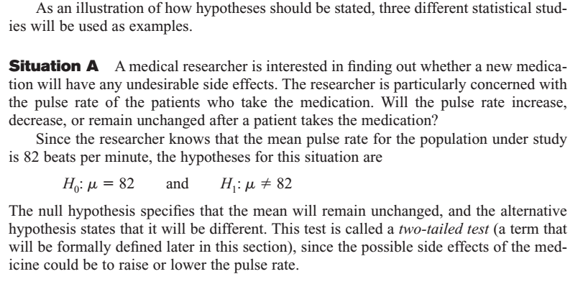
Test of hypothesis
Notes:
Faded picture background with full-color overlay
(Intermediate)
Tip: For best results with the picture overlay on this slide, use a picture that is the same dimensions as the slide: 7.5” high and 10” wide. If the picture is not the same height and width, resize or crop to those dimensions before following the instructions below.
To reproduce the background effects on this slide, do the following:
On the Home tab, in the Slides group, click Layout, and then click Blank.
Right-click the slide and then click Format Background.
In the Format Background dialog box, click Fill in the left pane. In the Fill pane, select Picture or texture fill, and then under Insert from, click File.
In the Insert Picture dialog box, select a picture, and then click Insert.
Also in the Format Background dialog box, in the Fill pane, in the Transparency box, enter 50%.
Also in the Format Background dialog box, click Picture Color in the left pane. In the Picture Color pane, under Recolor, click the button next to Presets, and then click Tan, Background color 2 Light (third row, first option from the left).
On the Insert tab, in the Images group, click Picture.
In the Insert Picture dialog box, select the same picture chosen for the background, and then click Insert.
Select the picture. Under Picture Tools, on the Format tab, in the bottom right corner of the Size group, click the Size and Position dialog box launcher. In the Format Picture dialog box, resize or crop the image so that the height is set to 7.5” and the width is set to 2.25”.
To crop the picture, click Crop in the left pane, and in the Crop pane, under Crop position, enter values into the Height, Width, Left, and Top boxes.
To resize the picture, click Size in the left pane, and in the Size pane, under Size and rotate, enter values into the Height and Width boxes.
Also in the Format Picture dialog box, click Glow and Soft Edges in the left pane, and then in the Glow and Soft Edges pane, under Soft Edges, in the Size box enter 10 point.

Slide 6
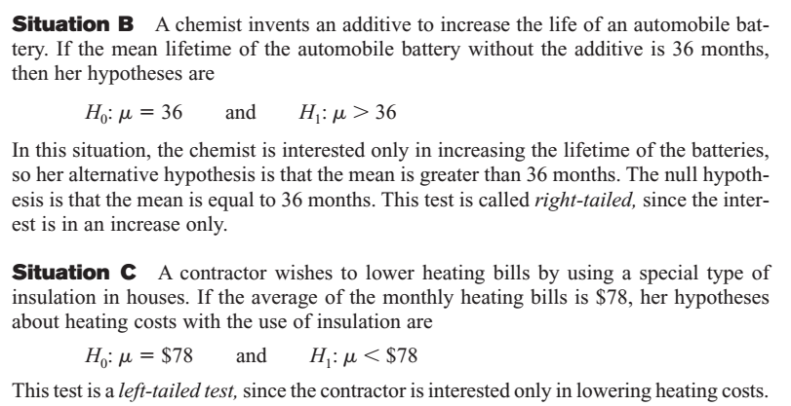
Test of hypothesis
Notes:
Faded picture background with full-color overlay
(Intermediate)
Tip: For best results with the picture overlay on this slide, use a picture that is the same dimensions as the slide: 7.5” high and 10” wide. If the picture is not the same height and width, resize or crop to those dimensions before following the instructions below.
To reproduce the background effects on this slide, do the following:
On the Home tab, in the Slides group, click Layout, and then click Blank.
Right-click the slide and then click Format Background.
In the Format Background dialog box, click Fill in the left pane. In the Fill pane, select Picture or texture fill, and then under Insert from, click File.
In the Insert Picture dialog box, select a picture, and then click Insert.
Also in the Format Background dialog box, in the Fill pane, in the Transparency box, enter 50%.
Also in the Format Background dialog box, click Picture Color in the left pane. In the Picture Color pane, under Recolor, click the button next to Presets, and then click Tan, Background color 2 Light (third row, first option from the left).
On the Insert tab, in the Images group, click Picture.
In the Insert Picture dialog box, select the same picture chosen for the background, and then click Insert.
Select the picture. Under Picture Tools, on the Format tab, in the bottom right corner of the Size group, click the Size and Position dialog box launcher. In the Format Picture dialog box, resize or crop the image so that the height is set to 7.5” and the width is set to 2.25”.
To crop the picture, click Crop in the left pane, and in the Crop pane, under Crop position, enter values into the Height, Width, Left, and Top boxes.
To resize the picture, click Size in the left pane, and in the Size pane, under Size and rotate, enter values into the Height and Width boxes.
Also in the Format Picture dialog box, click Glow and Soft Edges in the left pane, and then in the Glow and Soft Edges pane, under Soft Edges, in the Size box enter 10 point.

Slide 7
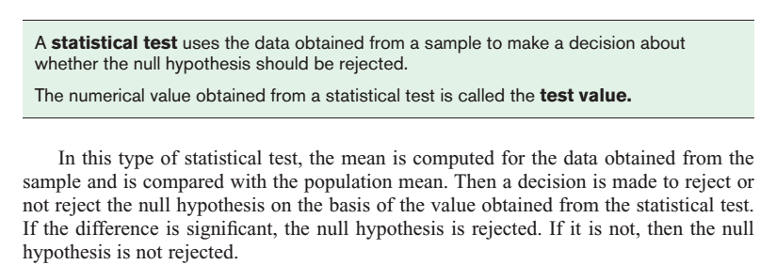
Test of hypothesis
Notes:
Faded picture background with full-color overlay
(Intermediate)
Tip: For best results with the picture overlay on this slide, use a picture that is the same dimensions as the slide: 7.5” high and 10” wide. If the picture is not the same height and width, resize or crop to those dimensions before following the instructions below.
To reproduce the background effects on this slide, do the following:
On the Home tab, in the Slides group, click Layout, and then click Blank.
Right-click the slide and then click Format Background.
In the Format Background dialog box, click Fill in the left pane. In the Fill pane, select Picture or texture fill, and then under Insert from, click File.
In the Insert Picture dialog box, select a picture, and then click Insert.
Also in the Format Background dialog box, in the Fill pane, in the Transparency box, enter 50%.
Also in the Format Background dialog box, click Picture Color in the left pane. In the Picture Color pane, under Recolor, click the button next to Presets, and then click Tan, Background color 2 Light (third row, first option from the left).
On the Insert tab, in the Images group, click Picture.
In the Insert Picture dialog box, select the same picture chosen for the background, and then click Insert.
Select the picture. Under Picture Tools, on the Format tab, in the bottom right corner of the Size group, click the Size and Position dialog box launcher. In the Format Picture dialog box, resize or crop the image so that the height is set to 7.5” and the width is set to 2.25”.
To crop the picture, click Crop in the left pane, and in the Crop pane, under Crop position, enter values into the Height, Width, Left, and Top boxes.
To resize the picture, click Size in the left pane, and in the Size pane, under Size and rotate, enter values into the Height and Width boxes.
Also in the Format Picture dialog box, click Glow and Soft Edges in the left pane, and then in the Glow and Soft Edges pane, under Soft Edges, in the Size box enter 10 point.

Slide 8
Test of hypothesis
Notes:
Faded picture background with full-color overlay
(Intermediate)
Tip: For best results with the picture overlay on this slide, use a picture that is the same dimensions as the slide: 7.5” high and 10” wide. If the picture is not the same height and width, resize or crop to those dimensions before following the instructions below.
To reproduce the background effects on this slide, do the following:
On the Home tab, in the Slides group, click Layout, and then click Blank.
Right-click the slide and then click Format Background.
In the Format Background dialog box, click Fill in the left pane. In the Fill pane, select Picture or texture fill, and then under Insert from, click File.
In the Insert Picture dialog box, select a picture, and then click Insert.
Also in the Format Background dialog box, in the Fill pane, in the Transparency box, enter 50%.
Also in the Format Background dialog box, click Picture Color in the left pane. In the Picture Color pane, under Recolor, click the button next to Presets, and then click Tan, Background color 2 Light (third row, first option from the left).
On the Insert tab, in the Images group, click Picture.
In the Insert Picture dialog box, select the same picture chosen for the background, and then click Insert.
Select the picture. Under Picture Tools, on the Format tab, in the bottom right corner of the Size group, click the Size and Position dialog box launcher. In the Format Picture dialog box, resize or crop the image so that the height is set to 7.5” and the width is set to 2.25”.
To crop the picture, click Crop in the left pane, and in the Crop pane, under Crop position, enter values into the Height, Width, Left, and Top boxes.
To resize the picture, click Size in the left pane, and in the Size pane, under Size and rotate, enter values into the Height and Width boxes.
Also in the Format Picture dialog box, click Glow and Soft Edges in the left pane, and then in the Glow and Soft Edges pane, under Soft Edges, in the Size box enter 10 point.

Slide 9
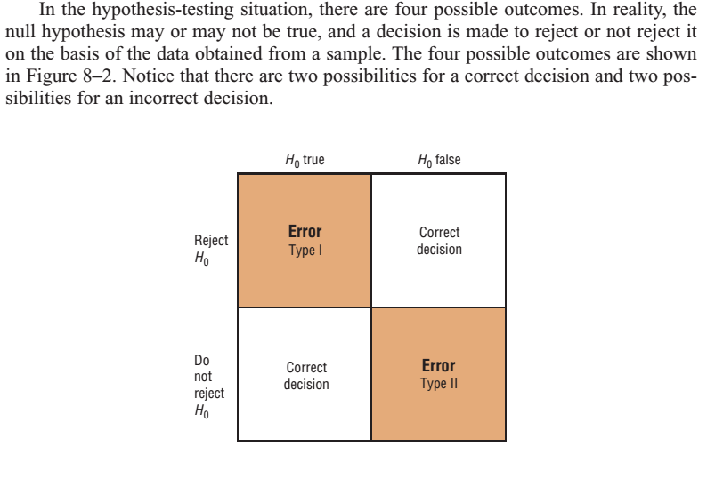
Test of hypothesis
Notes:
Faded picture background with full-color overlay
(Intermediate)
Tip: For best results with the picture overlay on this slide, use a picture that is the same dimensions as the slide: 7.5” high and 10” wide. If the picture is not the same height and width, resize or crop to those dimensions before following the instructions below.
To reproduce the background effects on this slide, do the following:
On the Home tab, in the Slides group, click Layout, and then click Blank.
Right-click the slide and then click Format Background.
In the Format Background dialog box, click Fill in the left pane. In the Fill pane, select Picture or texture fill, and then under Insert from, click File.
In the Insert Picture dialog box, select a picture, and then click Insert.
Also in the Format Background dialog box, in the Fill pane, in the Transparency box, enter 50%.
Also in the Format Background dialog box, click Picture Color in the left pane. In the Picture Color pane, under Recolor, click the button next to Presets, and then click Tan, Background color 2 Light (third row, first option from the left).
On the Insert tab, in the Images group, click Picture.
In the Insert Picture dialog box, select the same picture chosen for the background, and then click Insert.
Select the picture. Under Picture Tools, on the Format tab, in the bottom right corner of the Size group, click the Size and Position dialog box launcher. In the Format Picture dialog box, resize or crop the image so that the height is set to 7.5” and the width is set to 2.25”.
To crop the picture, click Crop in the left pane, and in the Crop pane, under Crop position, enter values into the Height, Width, Left, and Top boxes.
To resize the picture, click Size in the left pane, and in the Size pane, under Size and rotate, enter values into the Height and Width boxes.
Also in the Format Picture dialog box, click Glow and Soft Edges in the left pane, and then in the Glow and Soft Edges pane, under Soft Edges, in the Size box enter 10 point.

Slide 10
Test of hypothesis
Notes:
Faded picture background with full-color overlay
(Intermediate)
Tip: For best results with the picture overlay on this slide, use a picture that is the same dimensions as the slide: 7.5” high and 10” wide. If the picture is not the same height and width, resize or crop to those dimensions before following the instructions below.
To reproduce the background effects on this slide, do the following:
On the Home tab, in the Slides group, click Layout, and then click Blank.
Right-click the slide and then click Format Background.
In the Format Background dialog box, click Fill in the left pane. In the Fill pane, select Picture or texture fill, and then under Insert from, click File.
In the Insert Picture dialog box, select a picture, and then click Insert.
Also in the Format Background dialog box, in the Fill pane, in the Transparency box, enter 50%.
Also in the Format Background dialog box, click Picture Color in the left pane. In the Picture Color pane, under Recolor, click the button next to Presets, and then click Tan, Background color 2 Light (third row, first option from the left).
On the Insert tab, in the Images group, click Picture.
In the Insert Picture dialog box, select the same picture chosen for the background, and then click Insert.
Select the picture. Under Picture Tools, on the Format tab, in the bottom right corner of the Size group, click the Size and Position dialog box launcher. In the Format Picture dialog box, resize or crop the image so that the height is set to 7.5” and the width is set to 2.25”.
To crop the picture, click Crop in the left pane, and in the Crop pane, under Crop position, enter values into the Height, Width, Left, and Top boxes.
To resize the picture, click Size in the left pane, and in the Size pane, under Size and rotate, enter values into the Height and Width boxes.
Also in the Format Picture dialog box, click Glow and Soft Edges in the left pane, and then in the Glow and Soft Edges pane, under Soft Edges, in the Size box enter 10 point.

Slide 11
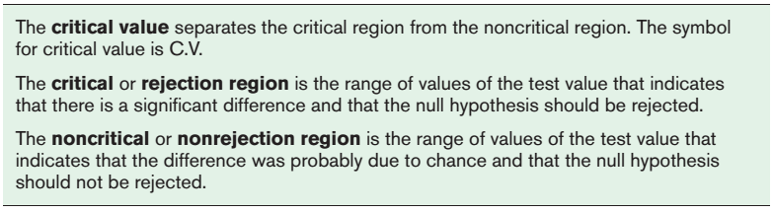
Test of hypothesis
After a significance level is chosen, a critical value is selected from a table for the appropriate test.
The critical value determines the critical and non-critical regions.
Notes:
Faded picture background with full-color overlay
(Intermediate)
Tip: For best results with the picture overlay on this slide, use a picture that is the same dimensions as the slide: 7.5” high and 10” wide. If the picture is not the same height and width, resize or crop to those dimensions before following the instructions below.
To reproduce the background effects on this slide, do the following:
On the Home tab, in the Slides group, click Layout, and then click Blank.
Right-click the slide and then click Format Background.
In the Format Background dialog box, click Fill in the left pane. In the Fill pane, select Picture or texture fill, and then under Insert from, click File.
In the Insert Picture dialog box, select a picture, and then click Insert.
Also in the Format Background dialog box, in the Fill pane, in the Transparency box, enter 50%.
Also in the Format Background dialog box, click Picture Color in the left pane. In the Picture Color pane, under Recolor, click the button next to Presets, and then click Tan, Background color 2 Light (third row, first option from the left).
On the Insert tab, in the Images group, click Picture.
In the Insert Picture dialog box, select the same picture chosen for the background, and then click Insert.
Select the picture. Under Picture Tools, on the Format tab, in the bottom right corner of the Size group, click the Size and Position dialog box launcher. In the Format Picture dialog box, resize or crop the image so that the height is set to 7.5” and the width is set to 2.25”.
To crop the picture, click Crop in the left pane, and in the Crop pane, under Crop position, enter values into the Height, Width, Left, and Top boxes.
To resize the picture, click Size in the left pane, and in the Size pane, under Size and rotate, enter values into the Height and Width boxes.
Also in the Format Picture dialog box, click Glow and Soft Edges in the left pane, and then in the Glow and Soft Edges pane, under Soft Edges, in the Size box enter 10 point.

Slide 12
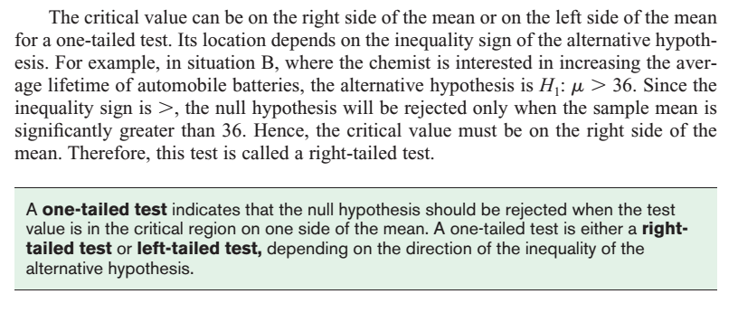
Test of hypothesis
Notes:
Faded picture background with full-color overlay
(Intermediate)
Tip: For best results with the picture overlay on this slide, use a picture that is the same dimensions as the slide: 7.5” high and 10” wide. If the picture is not the same height and width, resize or crop to those dimensions before following the instructions below.
To reproduce the background effects on this slide, do the following:
On the Home tab, in the Slides group, click Layout, and then click Blank.
Right-click the slide and then click Format Background.
In the Format Background dialog box, click Fill in the left pane. In the Fill pane, select Picture or texture fill, and then under Insert from, click File.
In the Insert Picture dialog box, select a picture, and then click Insert.
Also in the Format Background dialog box, in the Fill pane, in the Transparency box, enter 50%.
Also in the Format Background dialog box, click Picture Color in the left pane. In the Picture Color pane, under Recolor, click the button next to Presets, and then click Tan, Background color 2 Light (third row, first option from the left).
On the Insert tab, in the Images group, click Picture.
In the Insert Picture dialog box, select the same picture chosen for the background, and then click Insert.
Select the picture. Under Picture Tools, on the Format tab, in the bottom right corner of the Size group, click the Size and Position dialog box launcher. In the Format Picture dialog box, resize or crop the image so that the height is set to 7.5” and the width is set to 2.25”.
To crop the picture, click Crop in the left pane, and in the Crop pane, under Crop position, enter values into the Height, Width, Left, and Top boxes.
To resize the picture, click Size in the left pane, and in the Size pane, under Size and rotate, enter values into the Height and Width boxes.
Also in the Format Picture dialog box, click Glow and Soft Edges in the left pane, and then in the Glow and Soft Edges pane, under Soft Edges, in the Size box enter 10 point.

Slide 13
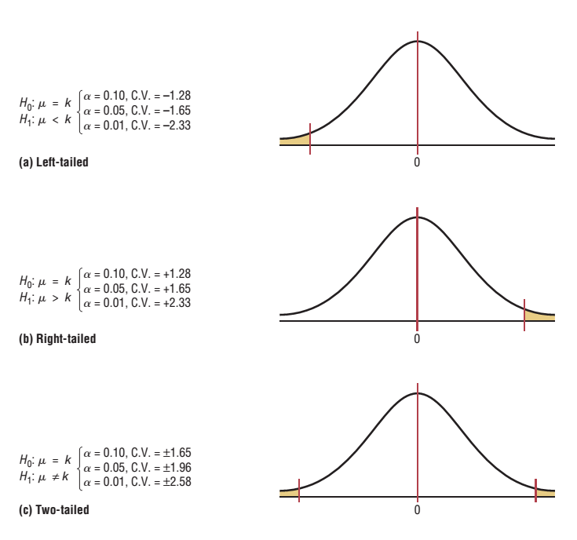
Test of hypothesis
Notes:
Faded picture background with full-color overlay
(Intermediate)
Tip: For best results with the picture overlay on this slide, use a picture that is the same dimensions as the slide: 7.5” high and 10” wide. If the picture is not the same height and width, resize or crop to those dimensions before following the instructions below.
To reproduce the background effects on this slide, do the following:
On the Home tab, in the Slides group, click Layout, and then click Blank.
Right-click the slide and then click Format Background.
In the Format Background dialog box, click Fill in the left pane. In the Fill pane, select Picture or texture fill, and then under Insert from, click File.
In the Insert Picture dialog box, select a picture, and then click Insert.
Also in the Format Background dialog box, in the Fill pane, in the Transparency box, enter 50%.
Also in the Format Background dialog box, click Picture Color in the left pane. In the Picture Color pane, under Recolor, click the button next to Presets, and then click Tan, Background color 2 Light (third row, first option from the left).
On the Insert tab, in the Images group, click Picture.
In the Insert Picture dialog box, select the same picture chosen for the background, and then click Insert.
Select the picture. Under Picture Tools, on the Format tab, in the bottom right corner of the Size group, click the Size and Position dialog box launcher. In the Format Picture dialog box, resize or crop the image so that the height is set to 7.5” and the width is set to 2.25”.
To crop the picture, click Crop in the left pane, and in the Crop pane, under Crop position, enter values into the Height, Width, Left, and Top boxes.
To resize the picture, click Size in the left pane, and in the Size pane, under Size and rotate, enter values into the Height and Width boxes.
Also in the Format Picture dialog box, click Glow and Soft Edges in the left pane, and then in the Glow and Soft Edges pane, under Soft Edges, in the Size box enter 10 point.

Slide 14
Test of hypothesis
Notes:
Faded picture background with full-color overlay
(Intermediate)
Tip: For best results with the picture overlay on this slide, use a picture that is the same dimensions as the slide: 7.5” high and 10” wide. If the picture is not the same height and width, resize or crop to those dimensions before following the instructions below.
To reproduce the background effects on this slide, do the following:
On the Home tab, in the Slides group, click Layout, and then click Blank.
Right-click the slide and then click Format Background.
In the Format Background dialog box, click Fill in the left pane. In the Fill pane, select Picture or texture fill, and then under Insert from, click File.
In the Insert Picture dialog box, select a picture, and then click Insert.
Also in the Format Background dialog box, in the Fill pane, in the Transparency box, enter 50%.
Also in the Format Background dialog box, click Picture Color in the left pane. In the Picture Color pane, under Recolor, click the button next to Presets, and then click Tan, Background color 2 Light (third row, first option from the left).
On the Insert tab, in the Images group, click Picture.
In the Insert Picture dialog box, select the same picture chosen for the background, and then click Insert.
Select the picture. Under Picture Tools, on the Format tab, in the bottom right corner of the Size group, click the Size and Position dialog box launcher. In the Format Picture dialog box, resize or crop the image so that the height is set to 7.5” and the width is set to 2.25”.
To crop the picture, click Crop in the left pane, and in the Crop pane, under Crop position, enter values into the Height, Width, Left, and Top boxes.
To resize the picture, click Size in the left pane, and in the Size pane, under Size and rotate, enter values into the Height and Width boxes.
Also in the Format Picture dialog box, click Glow and Soft Edges in the left pane, and then in the Glow and Soft Edges pane, under Soft Edges, in the Size box enter 10 point.

Slide 15
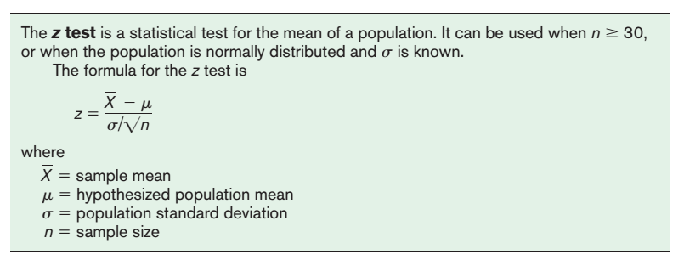
Notes:
Faded picture background with full-color overlay
(Intermediate)
Tip: For best results with the picture overlay on this slide, use a picture that is the same dimensions as the slide: 7.5” high and 10” wide. If the picture is not the same height and width, resize or crop to those dimensions before following the instructions below.
To reproduce the background effects on this slide, do the following:
On the Home tab, in the Slides group, click Layout, and then click Blank.
Right-click the slide and then click Format Background.
In the Format Background dialog box, click Fill in the left pane. In the Fill pane, select Picture or texture fill, and then under Insert from, click File.
In the Insert Picture dialog box, select a picture, and then click Insert.
Also in the Format Background dialog box, in the Fill pane, in the Transparency box, enter 50%.
Also in the Format Background dialog box, click Picture Color in the left pane. In the Picture Color pane, under Recolor, click the button next to Presets, and then click Tan, Background color 2 Light (third row, first option from the left).
On the Insert tab, in the Images group, click Picture.
In the Insert Picture dialog box, select the same picture chosen for the background, and then click Insert.
Select the picture. Under Picture Tools, on the Format tab, in the bottom right corner of the Size group, click the Size and Position dialog box launcher. In the Format Picture dialog box, resize or crop the image so that the height is set to 7.5” and the width is set to 2.25”.
To crop the picture, click Crop in the left pane, and in the Crop pane, under Crop position, enter values into the Height, Width, Left, and Top boxes.
To resize the picture, click Size in the left pane, and in the Size pane, under Size and rotate, enter values into the Height and Width boxes.
Also in the Format Picture dialog box, click Glow and Soft Edges in the left pane, and then in the Glow and Soft Edges pane, under Soft Edges, in the Size box enter 10 point.

Slide 16
Notes:
Faded picture background with full-color overlay
(Intermediate)
Tip: For best results with the picture overlay on this slide, use a picture that is the same dimensions as the slide: 7.5” high and 10” wide. If the picture is not the same height and width, resize or crop to those dimensions before following the instructions below.
To reproduce the background effects on this slide, do the following:
On the Home tab, in the Slides group, click Layout, and then click Blank.
Right-click the slide and then click Format Background.
In the Format Background dialog box, click Fill in the left pane. In the Fill pane, select Picture or texture fill, and then under Insert from, click File.
In the Insert Picture dialog box, select a picture, and then click Insert.
Also in the Format Background dialog box, in the Fill pane, in the Transparency box, enter 50%.
Also in the Format Background dialog box, click Picture Color in the left pane. In the Picture Color pane, under Recolor, click the button next to Presets, and then click Tan, Background color 2 Light (third row, first option from the left).
On the Insert tab, in the Images group, click Picture.
In the Insert Picture dialog box, select the same picture chosen for the background, and then click Insert.
Select the picture. Under Picture Tools, on the Format tab, in the bottom right corner of the Size group, click the Size and Position dialog box launcher. In the Format Picture dialog box, resize or crop the image so that the height is set to 7.5” and the width is set to 2.25”.
To crop the picture, click Crop in the left pane, and in the Crop pane, under Crop position, enter values into the Height, Width, Left, and Top boxes.
To resize the picture, click Size in the left pane, and in the Size pane, under Size and rotate, enter values into the Height and Width boxes.
Also in the Format Picture dialog box, click Glow and Soft Edges in the left pane, and then in the Glow and Soft Edges pane, under Soft Edges, in the Size box enter 10 point.

Slide 17
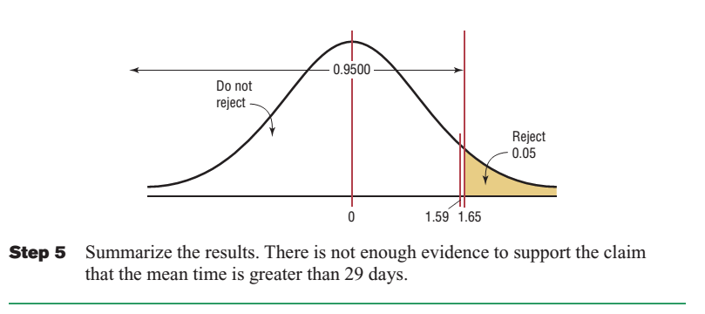
Notes:
Faded picture background with full-color overlay
(Intermediate)
Tip: For best results with the picture overlay on this slide, use a picture that is the same dimensions as the slide: 7.5” high and 10” wide. If the picture is not the same height and width, resize or crop to those dimensions before following the instructions below.
To reproduce the background effects on this slide, do the following:
On the Home tab, in the Slides group, click Layout, and then click Blank.
Right-click the slide and then click Format Background.
In the Format Background dialog box, click Fill in the left pane. In the Fill pane, select Picture or texture fill, and then under Insert from, click File.
In the Insert Picture dialog box, select a picture, and then click Insert.
Also in the Format Background dialog box, in the Fill pane, in the Transparency box, enter 50%.
Also in the Format Background dialog box, click Picture Color in the left pane. In the Picture Color pane, under Recolor, click the button next to Presets, and then click Tan, Background color 2 Light (third row, first option from the left).
On the Insert tab, in the Images group, click Picture.
In the Insert Picture dialog box, select the same picture chosen for the background, and then click Insert.
Select the picture. Under Picture Tools, on the Format tab, in the bottom right corner of the Size group, click the Size and Position dialog box launcher. In the Format Picture dialog box, resize or crop the image so that the height is set to 7.5” and the width is set to 2.25”.
To crop the picture, click Crop in the left pane, and in the Crop pane, under Crop position, enter values into the Height, Width, Left, and Top boxes.
To resize the picture, click Size in the left pane, and in the Size pane, under Size and rotate, enter values into the Height and Width boxes.
Also in the Format Picture dialog box, click Glow and Soft Edges in the left pane, and then in the Glow and Soft Edges pane, under Soft Edges, in the Size box enter 10 point.

Slide 18
Notes:
Faded picture background with full-color overlay
(Intermediate)
Tip: For best results with the picture overlay on this slide, use a picture that is the same dimensions as the slide: 7.5” high and 10” wide. If the picture is not the same height and width, resize or crop to those dimensions before following the instructions below.
To reproduce the background effects on this slide, do the following:
On the Home tab, in the Slides group, click Layout, and then click Blank.
Right-click the slide and then click Format Background.
In the Format Background dialog box, click Fill in the left pane. In the Fill pane, select Picture or texture fill, and then under Insert from, click File.
In the Insert Picture dialog box, select a picture, and then click Insert.
Also in the Format Background dialog box, in the Fill pane, in the Transparency box, enter 50%.
Also in the Format Background dialog box, click Picture Color in the left pane. In the Picture Color pane, under Recolor, click the button next to Presets, and then click Tan, Background color 2 Light (third row, first option from the left).
On the Insert tab, in the Images group, click Picture.
In the Insert Picture dialog box, select the same picture chosen for the background, and then click Insert.
Select the picture. Under Picture Tools, on the Format tab, in the bottom right corner of the Size group, click the Size and Position dialog box launcher. In the Format Picture dialog box, resize or crop the image so that the height is set to 7.5” and the width is set to 2.25”.
To crop the picture, click Crop in the left pane, and in the Crop pane, under Crop position, enter values into the Height, Width, Left, and Top boxes.
To resize the picture, click Size in the left pane, and in the Size pane, under Size and rotate, enter values into the Height and Width boxes.
Also in the Format Picture dialog box, click Glow and Soft Edges in the left pane, and then in the Glow and Soft Edges pane, under Soft Edges, in the Size box enter 10 point.

Slide 19
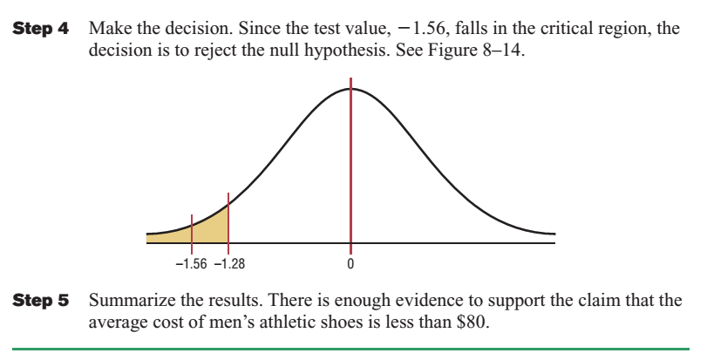
Notes:
Faded picture background with full-color overlay
(Intermediate)
Tip: For best results with the picture overlay on this slide, use a picture that is the same dimensions as the slide: 7.5” high and 10” wide. If the picture is not the same height and width, resize or crop to those dimensions before following the instructions below.
To reproduce the background effects on this slide, do the following:
On the Home tab, in the Slides group, click Layout, and then click Blank.
Right-click the slide and then click Format Background.
In the Format Background dialog box, click Fill in the left pane. In the Fill pane, select Picture or texture fill, and then under Insert from, click File.
In the Insert Picture dialog box, select a picture, and then click Insert.
Also in the Format Background dialog box, in the Fill pane, in the Transparency box, enter 50%.
Also in the Format Background dialog box, click Picture Color in the left pane. In the Picture Color pane, under Recolor, click the button next to Presets, and then click Tan, Background color 2 Light (third row, first option from the left).
On the Insert tab, in the Images group, click Picture.
In the Insert Picture dialog box, select the same picture chosen for the background, and then click Insert.
Select the picture. Under Picture Tools, on the Format tab, in the bottom right corner of the Size group, click the Size and Position dialog box launcher. In the Format Picture dialog box, resize or crop the image so that the height is set to 7.5” and the width is set to 2.25”.
To crop the picture, click Crop in the left pane, and in the Crop pane, under Crop position, enter values into the Height, Width, Left, and Top boxes.
To resize the picture, click Size in the left pane, and in the Size pane, under Size and rotate, enter values into the Height and Width boxes.
Also in the Format Picture dialog box, click Glow and Soft Edges in the left pane, and then in the Glow and Soft Edges pane, under Soft Edges, in the Size box enter 10 point.

Slide 20
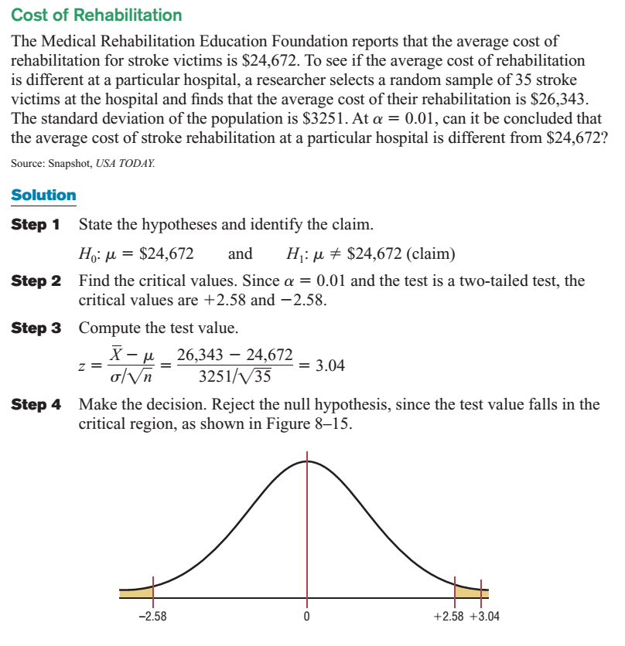
Notes:
Faded picture background with full-color overlay
(Intermediate)
Tip: For best results with the picture overlay on this slide, use a picture that is the same dimensions as the slide: 7.5” high and 10” wide. If the picture is not the same height and width, resize or crop to those dimensions before following the instructions below.
To reproduce the background effects on this slide, do the following:
On the Home tab, in the Slides group, click Layout, and then click Blank.
Right-click the slide and then click Format Background.
In the Format Background dialog box, click Fill in the left pane. In the Fill pane, select Picture or texture fill, and then under Insert from, click File.
In the Insert Picture dialog box, select a picture, and then click Insert.
Also in the Format Background dialog box, in the Fill pane, in the Transparency box, enter 50%.
Also in the Format Background dialog box, click Picture Color in the left pane. In the Picture Color pane, under Recolor, click the button next to Presets, and then click Tan, Background color 2 Light (third row, first option from the left).
On the Insert tab, in the Images group, click Picture.
In the Insert Picture dialog box, select the same picture chosen for the background, and then click Insert.
Select the picture. Under Picture Tools, on the Format tab, in the bottom right corner of the Size group, click the Size and Position dialog box launcher. In the Format Picture dialog box, resize or crop the image so that the height is set to 7.5” and the width is set to 2.25”.
To crop the picture, click Crop in the left pane, and in the Crop pane, under Crop position, enter values into the Height, Width, Left, and Top boxes.
To resize the picture, click Size in the left pane, and in the Size pane, under Size and rotate, enter values into the Height and Width boxes.
Also in the Format Picture dialog box, click Glow and Soft Edges in the left pane, and then in the Glow and Soft Edges pane, under Soft Edges, in the Size box enter 10 point.

Slide 21
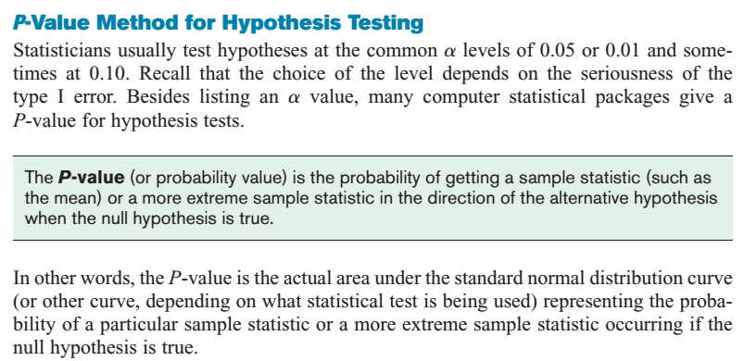
Notes:
Faded picture background with full-color overlay
(Intermediate)
Tip: For best results with the picture overlay on this slide, use a picture that is the same dimensions as the slide: 7.5” high and 10” wide. If the picture is not the same height and width, resize or crop to those dimensions before following the instructions below.
To reproduce the background effects on this slide, do the following:
On the Home tab, in the Slides group, click Layout, and then click Blank.
Right-click the slide and then click Format Background.
In the Format Background dialog box, click Fill in the left pane. In the Fill pane, select Picture or texture fill, and then under Insert from, click File.
In the Insert Picture dialog box, select a picture, and then click Insert.
Also in the Format Background dialog box, in the Fill pane, in the Transparency box, enter 50%.
Also in the Format Background dialog box, click Picture Color in the left pane. In the Picture Color pane, under Recolor, click the button next to Presets, and then click Tan, Background color 2 Light (third row, first option from the left).
On the Insert tab, in the Images group, click Picture.
In the Insert Picture dialog box, select the same picture chosen for the background, and then click Insert.
Select the picture. Under Picture Tools, on the Format tab, in the bottom right corner of the Size group, click the Size and Position dialog box launcher. In the Format Picture dialog box, resize or crop the image so that the height is set to 7.5” and the width is set to 2.25”.
To crop the picture, click Crop in the left pane, and in the Crop pane, under Crop position, enter values into the Height, Width, Left, and Top boxes.
To resize the picture, click Size in the left pane, and in the Size pane, under Size and rotate, enter values into the Height and Width boxes.
Also in the Format Picture dialog box, click Glow and Soft Edges in the left pane, and then in the Glow and Soft Edges pane, under Soft Edges, in the Size box enter 10 point.

Slide 22
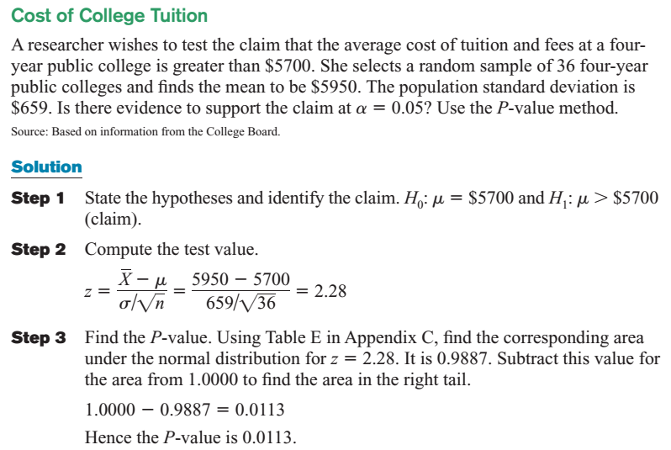
Notes:
Faded picture background with full-color overlay
(Intermediate)
Tip: For best results with the picture overlay on this slide, use a picture that is the same dimensions as the slide: 7.5” high and 10” wide. If the picture is not the same height and width, resize or crop to those dimensions before following the instructions below.
To reproduce the background effects on this slide, do the following:
On the Home tab, in the Slides group, click Layout, and then click Blank.
Right-click the slide and then click Format Background.
In the Format Background dialog box, click Fill in the left pane. In the Fill pane, select Picture or texture fill, and then under Insert from, click File.
In the Insert Picture dialog box, select a picture, and then click Insert.
Also in the Format Background dialog box, in the Fill pane, in the Transparency box, enter 50%.
Also in the Format Background dialog box, click Picture Color in the left pane. In the Picture Color pane, under Recolor, click the button next to Presets, and then click Tan, Background color 2 Light (third row, first option from the left).
On the Insert tab, in the Images group, click Picture.
In the Insert Picture dialog box, select the same picture chosen for the background, and then click Insert.
Select the picture. Under Picture Tools, on the Format tab, in the bottom right corner of the Size group, click the Size and Position dialog box launcher. In the Format Picture dialog box, resize or crop the image so that the height is set to 7.5” and the width is set to 2.25”.
To crop the picture, click Crop in the left pane, and in the Crop pane, under Crop position, enter values into the Height, Width, Left, and Top boxes.
To resize the picture, click Size in the left pane, and in the Size pane, under Size and rotate, enter values into the Height and Width boxes.
Also in the Format Picture dialog box, click Glow and Soft Edges in the left pane, and then in the Glow and Soft Edges pane, under Soft Edges, in the Size box enter 10 point.

Slide 23
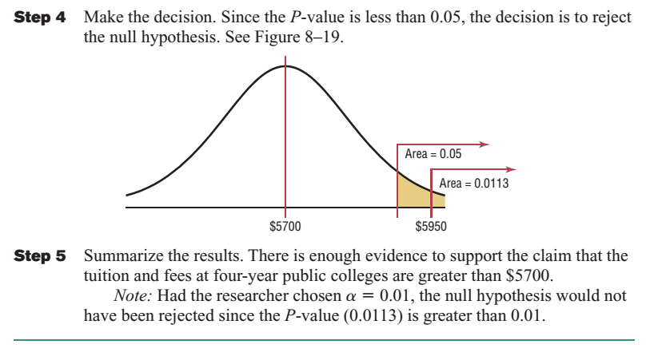
Notes:
Faded picture background with full-color overlay
(Intermediate)
Tip: For best results with the picture overlay on this slide, use a picture that is the same dimensions as the slide: 7.5” high and 10” wide. If the picture is not the same height and width, resize or crop to those dimensions before following the instructions below.
To reproduce the background effects on this slide, do the following:
On the Home tab, in the Slides group, click Layout, and then click Blank.
Right-click the slide and then click Format Background.
In the Format Background dialog box, click Fill in the left pane. In the Fill pane, select Picture or texture fill, and then under Insert from, click File.
In the Insert Picture dialog box, select a picture, and then click Insert.
Also in the Format Background dialog box, in the Fill pane, in the Transparency box, enter 50%.
Also in the Format Background dialog box, click Picture Color in the left pane. In the Picture Color pane, under Recolor, click the button next to Presets, and then click Tan, Background color 2 Light (third row, first option from the left).
On the Insert tab, in the Images group, click Picture.
In the Insert Picture dialog box, select the same picture chosen for the background, and then click Insert.
Select the picture. Under Picture Tools, on the Format tab, in the bottom right corner of the Size group, click the Size and Position dialog box launcher. In the Format Picture dialog box, resize or crop the image so that the height is set to 7.5” and the width is set to 2.25”.
To crop the picture, click Crop in the left pane, and in the Crop pane, under Crop position, enter values into the Height, Width, Left, and Top boxes.
To resize the picture, click Size in the left pane, and in the Size pane, under Size and rotate, enter values into the Height and Width boxes.
Also in the Format Picture dialog box, click Glow and Soft Edges in the left pane, and then in the Glow and Soft Edges pane, under Soft Edges, in the Size box enter 10 point.

Slide 24
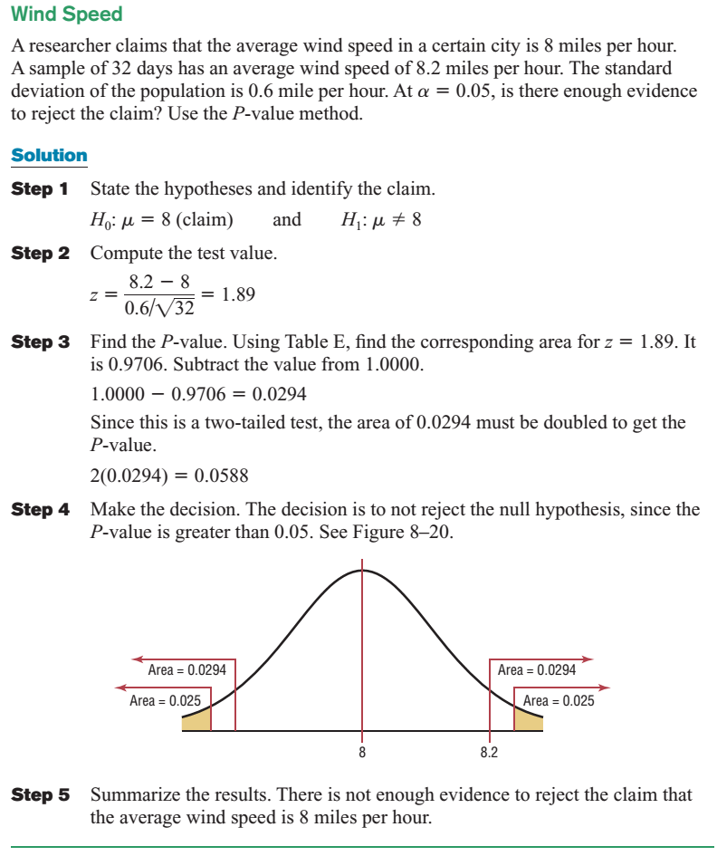
Notes:
Faded picture background with full-color overlay
(Intermediate)
Tip: For best results with the picture overlay on this slide, use a picture that is the same dimensions as the slide: 7.5” high and 10” wide. If the picture is not the same height and width, resize or crop to those dimensions before following the instructions below.
To reproduce the background effects on this slide, do the following:
On the Home tab, in the Slides group, click Layout, and then click Blank.
Right-click the slide and then click Format Background.
In the Format Background dialog box, click Fill in the left pane. In the Fill pane, select Picture or texture fill, and then under Insert from, click File.
In the Insert Picture dialog box, select a picture, and then click Insert.
Also in the Format Background dialog box, in the Fill pane, in the Transparency box, enter 50%.
Also in the Format Background dialog box, click Picture Color in the left pane. In the Picture Color pane, under Recolor, click the button next to Presets, and then click Tan, Background color 2 Light (third row, first option from the left).
On the Insert tab, in the Images group, click Picture.
In the Insert Picture dialog box, select the same picture chosen for the background, and then click Insert.
Select the picture. Under Picture Tools, on the Format tab, in the bottom right corner of the Size group, click the Size and Position dialog box launcher. In the Format Picture dialog box, resize or crop the image so that the height is set to 7.5” and the width is set to 2.25”.
To crop the picture, click Crop in the left pane, and in the Crop pane, under Crop position, enter values into the Height, Width, Left, and Top boxes.
To resize the picture, click Size in the left pane, and in the Size pane, under Size and rotate, enter values into the Height and Width boxes.
Also in the Format Picture dialog box, click Glow and Soft Edges in the left pane, and then in the Glow and Soft Edges pane, under Soft Edges, in the Size box enter 10 point.

Slide 25
Notes:
Faded picture background with full-color overlay
(Intermediate)
Tip: For best results with the picture overlay on this slide, use a picture that is the same dimensions as the slide: 7.5” high and 10” wide. If the picture is not the same height and width, resize or crop to those dimensions before following the instructions below.
To reproduce the background effects on this slide, do the following:
On the Home tab, in the Slides group, click Layout, and then click Blank.
Right-click the slide and then click Format Background.
In the Format Background dialog box, click Fill in the left pane. In the Fill pane, select Picture or texture fill, and then under Insert from, click File.
In the Insert Picture dialog box, select a picture, and then click Insert.
Also in the Format Background dialog box, in the Fill pane, in the Transparency box, enter 50%.
Also in the Format Background dialog box, click Picture Color in the left pane. In the Picture Color pane, under Recolor, click the button next to Presets, and then click Tan, Background color 2 Light (third row, first option from the left).
On the Insert tab, in the Images group, click Picture.
In the Insert Picture dialog box, select the same picture chosen for the background, and then click Insert.
Select the picture. Under Picture Tools, on the Format tab, in the bottom right corner of the Size group, click the Size and Position dialog box launcher. In the Format Picture dialog box, resize or crop the image so that the height is set to 7.5” and the width is set to 2.25”.
To crop the picture, click Crop in the left pane, and in the Crop pane, under Crop position, enter values into the Height, Width, Left, and Top boxes.
To resize the picture, click Size in the left pane, and in the Size pane, under Size and rotate, enter values into the Height and Width boxes.
Also in the Format Picture dialog box, click Glow and Soft Edges in the left pane, and then in the Glow and Soft Edges pane, under Soft Edges, in the Size box enter 10 point.

Slide 26
Notes:
Faded picture background with full-color overlay
(Intermediate)
Tip: For best results with the picture overlay on this slide, use a picture that is the same dimensions as the slide: 7.5” high and 10” wide. If the picture is not the same height and width, resize or crop to those dimensions before following the instructions below.
To reproduce the background effects on this slide, do the following:
On the Home tab, in the Slides group, click Layout, and then click Blank.
Right-click the slide and then click Format Background.
In the Format Background dialog box, click Fill in the left pane. In the Fill pane, select Picture or texture fill, and then under Insert from, click File.
In the Insert Picture dialog box, select a picture, and then click Insert.
Also in the Format Background dialog box, in the Fill pane, in the Transparency box, enter 50%.
Also in the Format Background dialog box, click Picture Color in the left pane. In the Picture Color pane, under Recolor, click the button next to Presets, and then click Tan, Background color 2 Light (third row, first option from the left).
On the Insert tab, in the Images group, click Picture.
In the Insert Picture dialog box, select the same picture chosen for the background, and then click Insert.
Select the picture. Under Picture Tools, on the Format tab, in the bottom right corner of the Size group, click the Size and Position dialog box launcher. In the Format Picture dialog box, resize or crop the image so that the height is set to 7.5” and the width is set to 2.25”.
To crop the picture, click Crop in the left pane, and in the Crop pane, under Crop position, enter values into the Height, Width, Left, and Top boxes.
To resize the picture, click Size in the left pane, and in the Size pane, under Size and rotate, enter values into the Height and Width boxes.
Also in the Format Picture dialog box, click Glow and Soft Edges in the left pane, and then in the Glow and Soft Edges pane, under Soft Edges, in the Size box enter 10 point.

Slide 27
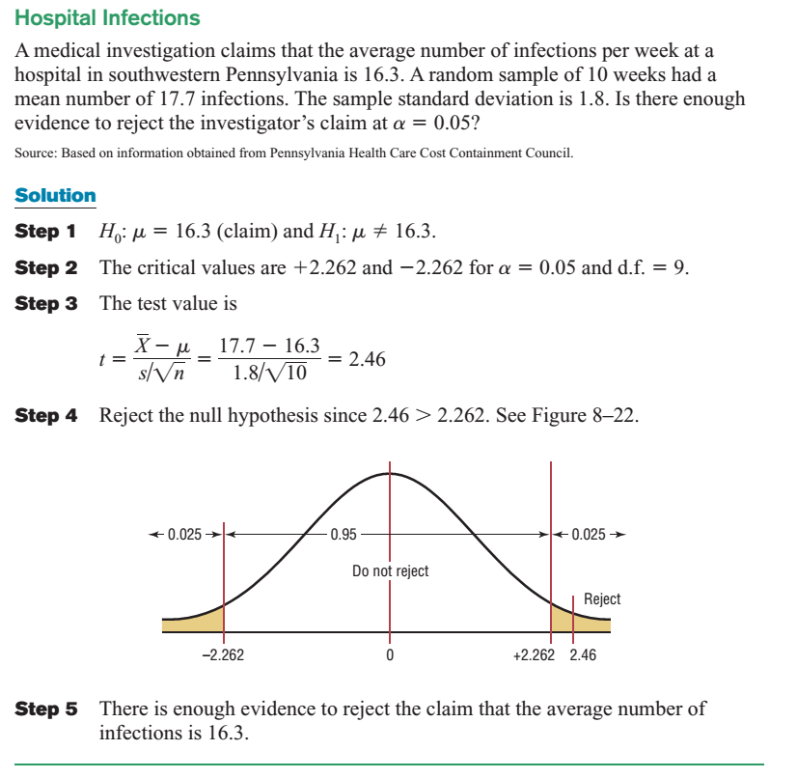
Notes:
Faded picture background with full-color overlay
(Intermediate)
Tip: For best results with the picture overlay on this slide, use a picture that is the same dimensions as the slide: 7.5” high and 10” wide. If the picture is not the same height and width, resize or crop to those dimensions before following the instructions below.
To reproduce the background effects on this slide, do the following:
On the Home tab, in the Slides group, click Layout, and then click Blank.
Right-click the slide and then click Format Background.
In the Format Background dialog box, click Fill in the left pane. In the Fill pane, select Picture or texture fill, and then under Insert from, click File.
In the Insert Picture dialog box, select a picture, and then click Insert.
Also in the Format Background dialog box, in the Fill pane, in the Transparency box, enter 50%.
Also in the Format Background dialog box, click Picture Color in the left pane. In the Picture Color pane, under Recolor, click the button next to Presets, and then click Tan, Background color 2 Light (third row, first option from the left).
On the Insert tab, in the Images group, click Picture.
In the Insert Picture dialog box, select the same picture chosen for the background, and then click Insert.
Select the picture. Under Picture Tools, on the Format tab, in the bottom right corner of the Size group, click the Size and Position dialog box launcher. In the Format Picture dialog box, resize or crop the image so that the height is set to 7.5” and the width is set to 2.25”.
To crop the picture, click Crop in the left pane, and in the Crop pane, under Crop position, enter values into the Height, Width, Left, and Top boxes.
To resize the picture, click Size in the left pane, and in the Size pane, under Size and rotate, enter values into the Height and Width boxes.
Also in the Format Picture dialog box, click Glow and Soft Edges in the left pane, and then in the Glow and Soft Edges pane, under Soft Edges, in the Size box enter 10 point.

Slide 28
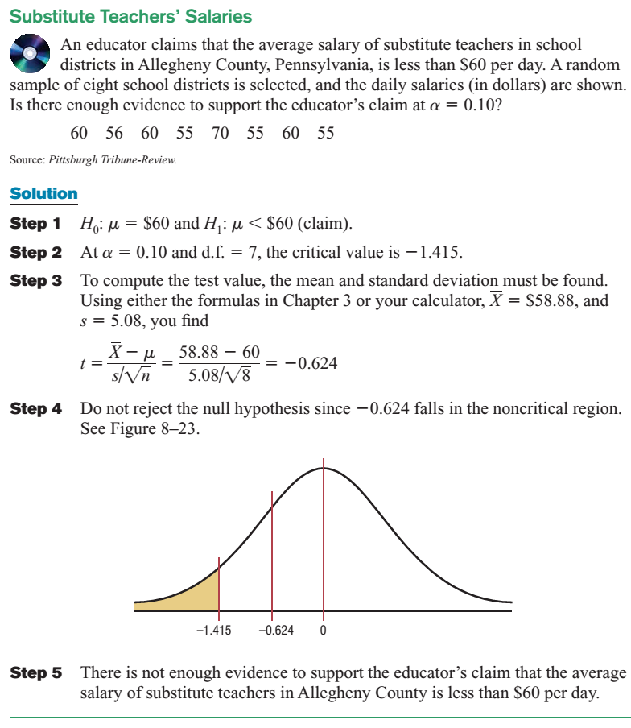
Notes:
Faded picture background with full-color overlay
(Intermediate)
Tip: For best results with the picture overlay on this slide, use a picture that is the same dimensions as the slide: 7.5” high and 10” wide. If the picture is not the same height and width, resize or crop to those dimensions before following the instructions below.
To reproduce the background effects on this slide, do the following:
On the Home tab, in the Slides group, click Layout, and then click Blank.
Right-click the slide and then click Format Background.
In the Format Background dialog box, click Fill in the left pane. In the Fill pane, select Picture or texture fill, and then under Insert from, click File.
In the Insert Picture dialog box, select a picture, and then click Insert.
Also in the Format Background dialog box, in the Fill pane, in the Transparency box, enter 50%.
Also in the Format Background dialog box, click Picture Color in the left pane. In the Picture Color pane, under Recolor, click the button next to Presets, and then click Tan, Background color 2 Light (third row, first option from the left).
On the Insert tab, in the Images group, click Picture.
In the Insert Picture dialog box, select the same picture chosen for the background, and then click Insert.
Select the picture. Under Picture Tools, on the Format tab, in the bottom right corner of the Size group, click the Size and Position dialog box launcher. In the Format Picture dialog box, resize or crop the image so that the height is set to 7.5” and the width is set to 2.25”.
To crop the picture, click Crop in the left pane, and in the Crop pane, under Crop position, enter values into the Height, Width, Left, and Top boxes.
To resize the picture, click Size in the left pane, and in the Size pane, under Size and rotate, enter values into the Height and Width boxes.
Also in the Format Picture dialog box, click Glow and Soft Edges in the left pane, and then in the Glow and Soft Edges pane, under Soft Edges, in the Size box enter 10 point.

